Slide 1
Mini Project 1
COSC445
10 Versions of the Odyssey from Project Gutenberg texts
Results from cliddel2.ipynb

Slide 2
RESEARCH QUESTION
What was the question?
How much does word choice change across English versions of the Odyssey and can vocabulary patterns show differences between translations and rewrites?
23,571 – 181,062
~300 (1614-1912)
5 + 5
Word counts
years
translations + rewrites
Goal: use digital archaeology methods to reveal patterns that are difficult to see by reading one version at a time.
Source: cliddel2.ipynb
2

Slide 3
METHOD
What was the approach?
1
Collect
Downloaded 10 Odyssey texts from Project Gutenberg.
2
Clean
Removed Gutenberg wrappers, lowercased the text, and tokenized words.
3
Count
Measured total words, common words, and words unique to each version.
4
Compare
Calculated pairwise cosine similarity from word-frequency profiles.
Text-processing choice: standard English stopwords were removed, plus “thy,” “thou,” “thee,” and “thus.”
Source: cliddel2.ipynb
3

Slide 4
CHALLENGES AND LIMITATIONS
What problems did I encounter?
• Choosing stop word lists: Old pronouns and language seemed unnecessary to compare.
• Slight vocabulary differences (Telemachus vs Telemachos, etc.)
• Some versions of the text contained more than just the Odyssey
• Couldn’t find any easily downloadable modern translations (Post 1950)
Source: cliddel2.ipynb
4

Slide 5
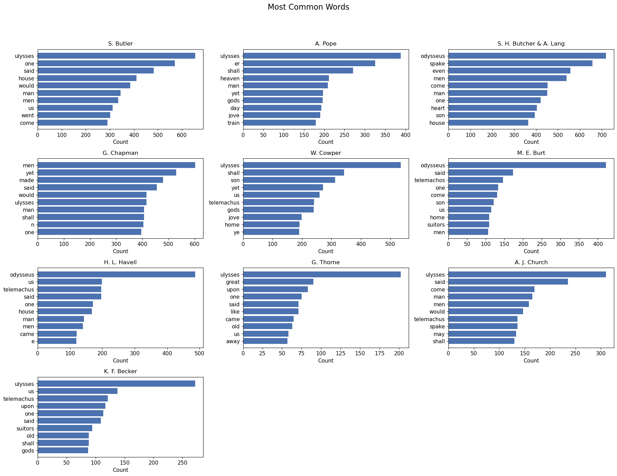
RESULTS
What results did I get? — Most common words
Across versions, recurring character names and story-related vocabulary remain prominent.
Source: cliddel2.ipynb
5

Slide 6
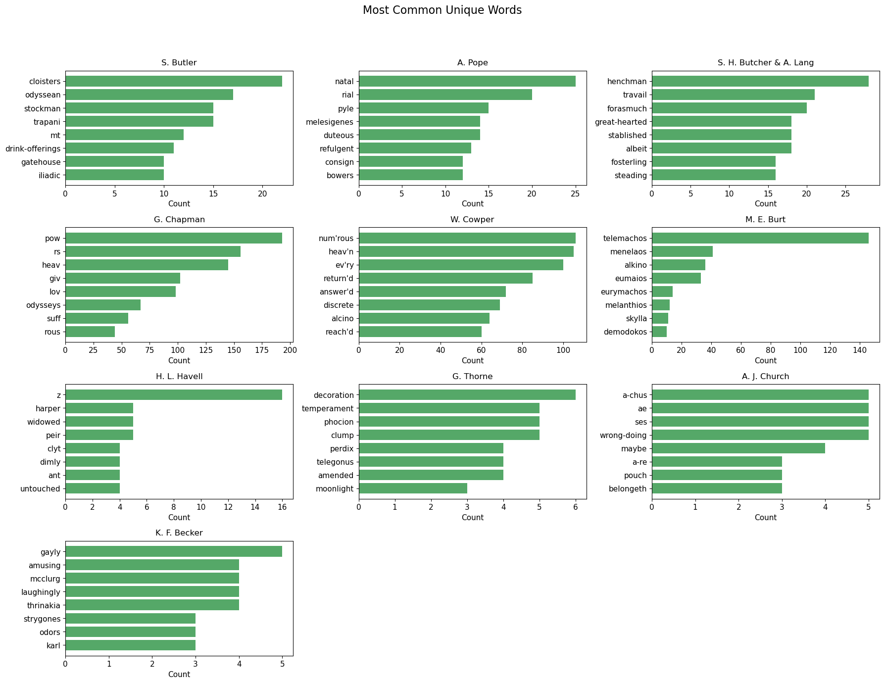
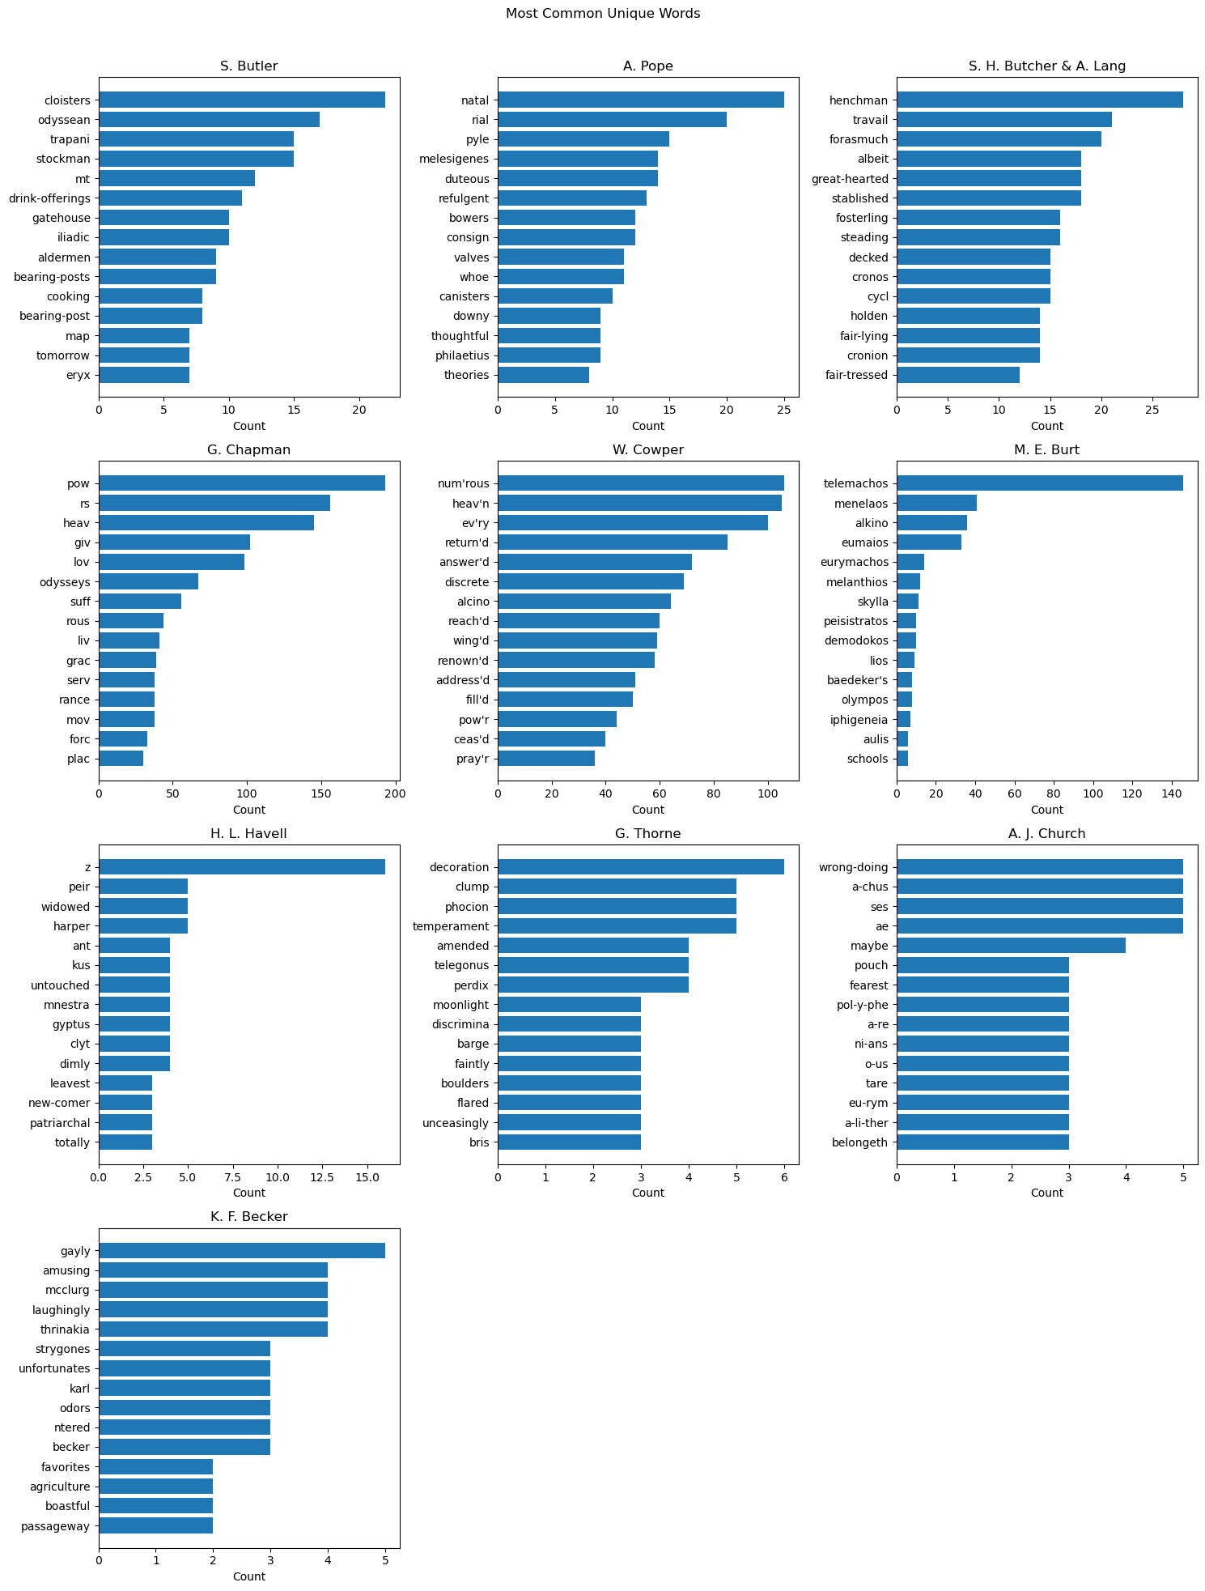
RESULTS
What results did I get? — Unique words
Unique-word patterns show where individual translators and adapters introduce distinctive vocabulary.
Source: cliddel2.ipynb
6

Slide 7
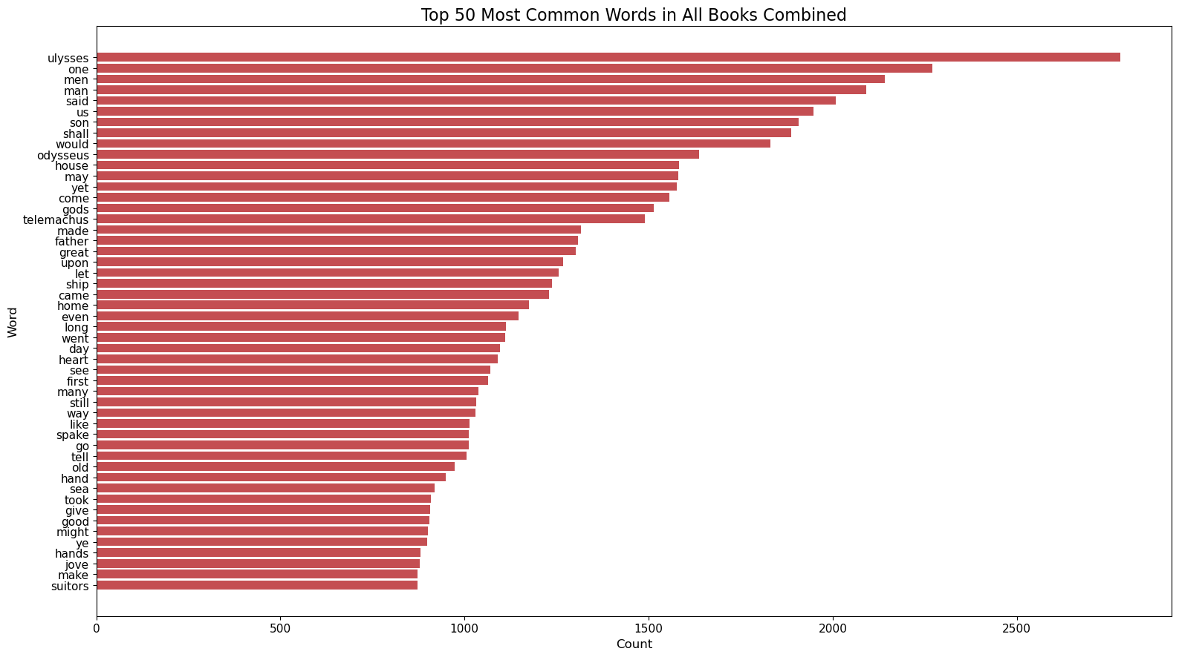
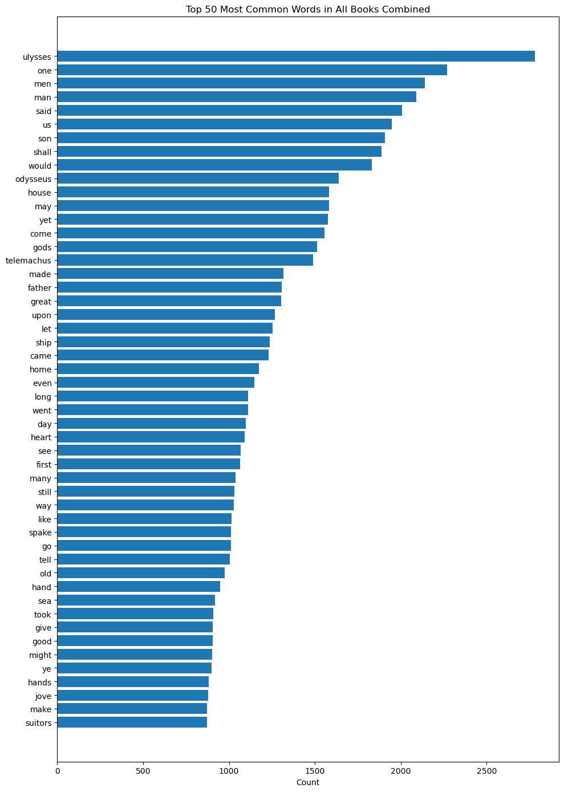
RESULTS
What results did I get? — All books combined
This combined view highlights the vocabulary that dominates the corpus as a whole.
Source: cliddel2.ipynb
7

Slide 8
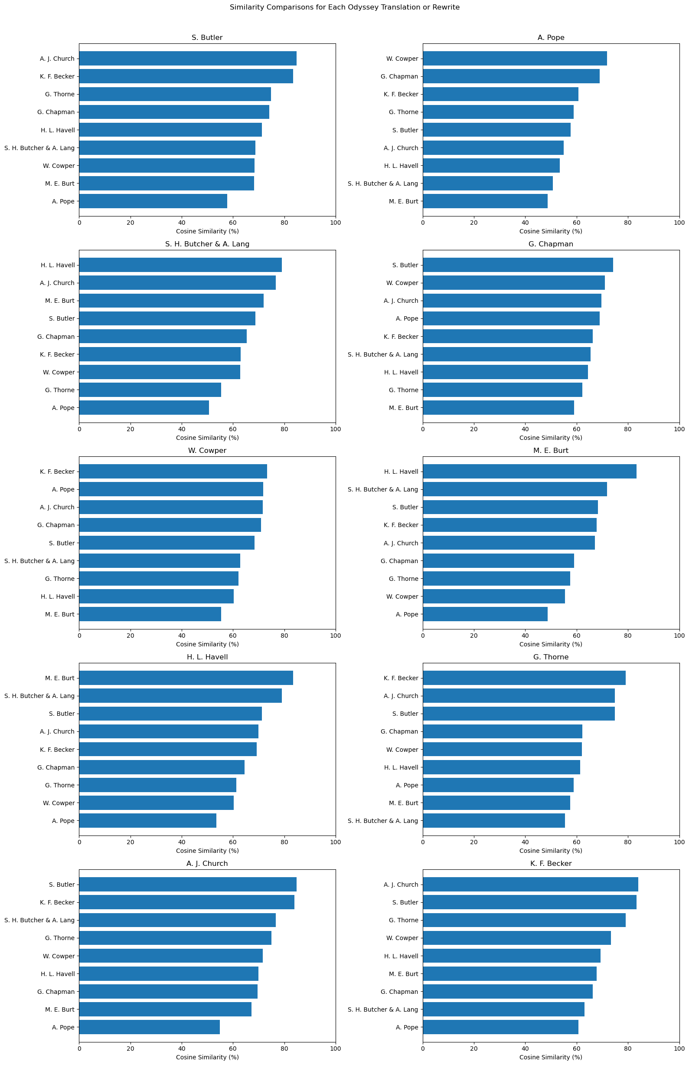
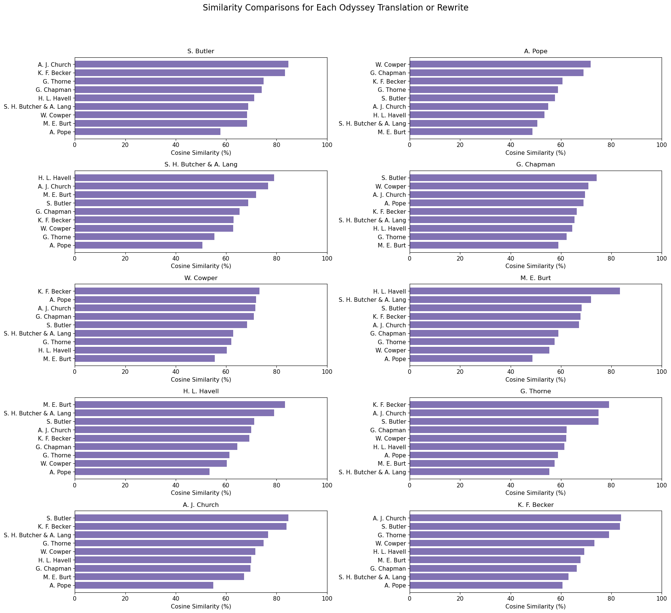
RESULTS
What results did I get? — Similarity
Highest similarity: S. Butler ↔ A. J. Church (84.77%) • Lowest: A. Pope ↔ M. E. Burt (48.64%)
Source: cliddel2.ipynb
8

Slide 9
NEXT QUESTIONS
What new ideas did this generate?
Compare Chapters
Analyze the same scenes or books across versions instead of whole texts.
Test time and type separately
Separate the effects of publication year, translation vs. rewrite, and individual author style.
Expand Sample Size
Add modern translations and examine names, themes, sentiment, or key concepts across centuries.
Big takeaway: the story stays recognizable, but each translator or adapter leaves a mark.
Source: cliddel2.ipynb
9

